Slide 1


Slide 2
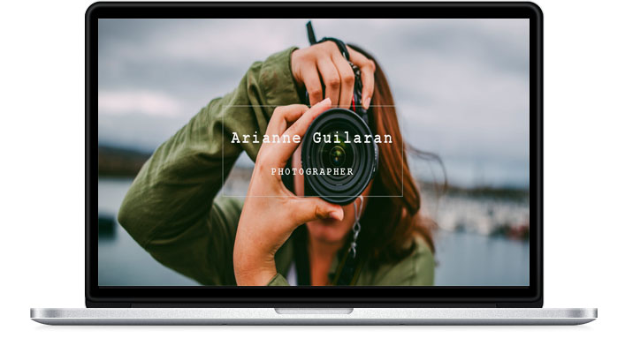
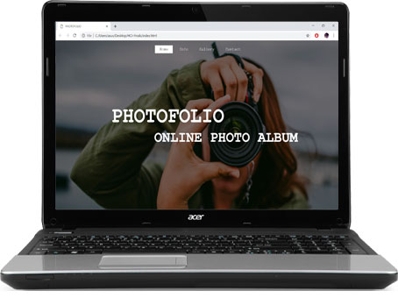

Slide 3
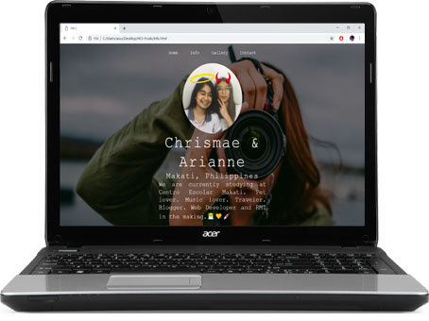
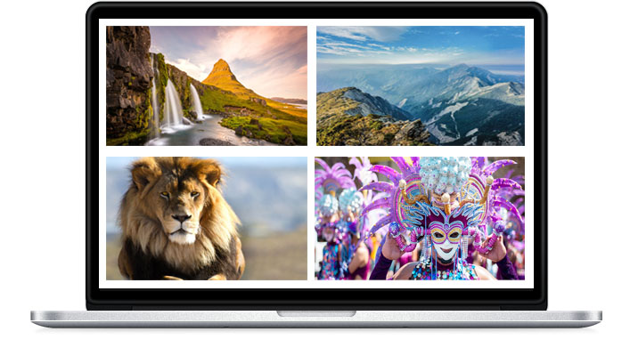

Slide 4
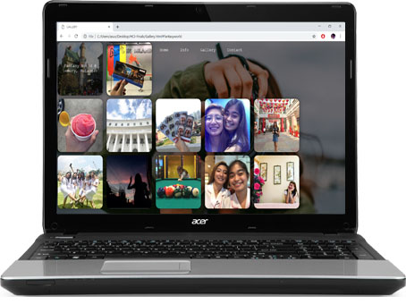
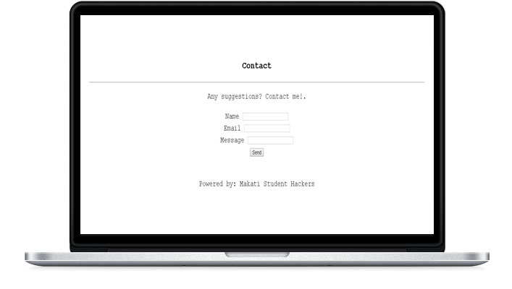
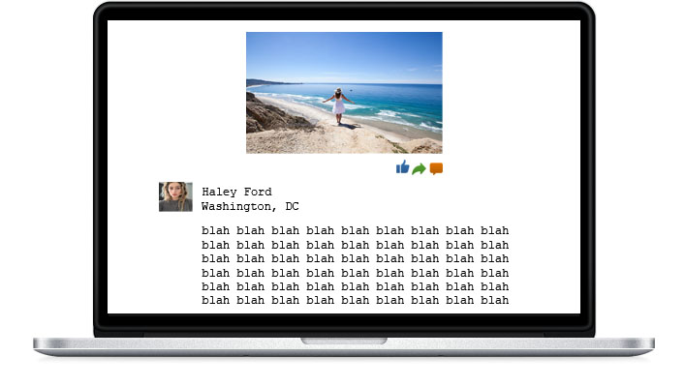

Slide 5
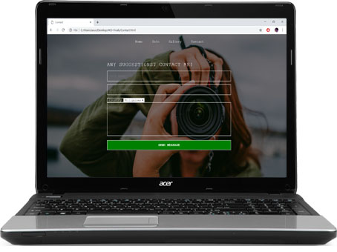

Slide 6
PHOTOFOLIO’S FEATURES

Slide 7
SIMPLE USER INTERFACE & ACCESSIBLE TO ALL USERS
A user-friendly website that has simple user interface and easy accessible for all the users in any age.

Slide 8
EFFECTIVE NAVIGATION
It has a good search feature, multiple ways to explore, easy uploading of photos, fast button action

Slide 9
MOBILE COMPATABILITY
People can use their phones to access this website with no hassle and fast loading

Slide 10
PHOTOFOLIO’S ADVANTAGES

Slide 11
ONLINE TRAVEL JOURNAL
This website will serves as an online photo album for the people who likes adventure, food trips and exciting activities

Slide 12
LEARN NEW SKILLS
This website will help other users to know the other skills they could learn in a particular thing and may see some of the places they have never been on

